Slide 1
INTRODUCTION TO PYTHON
A readable, dynamic, pleasant,
flexible, fast and powerful language
Tong Nguyen

Slide 2
Overview
Background
Syntax
Types / Operators / Control Flow
Working with IO
Functions
Classes (OOP) (optional)

Slide 3
What is Python
Multi-purpose (Web, GUI, Scripting, etc.)
Object Oriented
Interpreted
Dynamic typed
Focus on readability and productivity
Notes:
The traditional, simplified, definition of dynamically typed languages are that they do not enforce or check type-safety at compile-time, deferring such checks until run-time.
A programming language that requires a variable to be defined as well as the variable it is. For example, C is a strong typed language, when declaring the variable you must also specify the variable type

Slide 4
Releases
Created in 1989 by Guido Van Rossum
Python 1.0 released in 1994
Python 2.0 released in 2000
Python 3.0 released in 2008
Python 2.7 is the recommended version

Slide 5
Interpreters
Python is popularly known as an interpreted language, Python code need an interpreter to run
Available interpreters:
CPython (C implementation)
Jython (Java implementation)
Iron Python (.NET implementation)

Slide 6
Static typed versus dynamic typed
Static type
int i = 3;
String s = “4”;
int x = i + s;
Dynamic type
i = 3
s = “4”
x = i + s

Slide 7
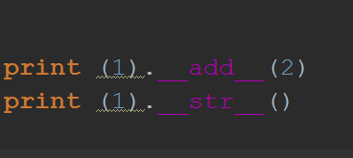
Everything is an object

Slide 8
Syntax & Built-in types

Slide 9
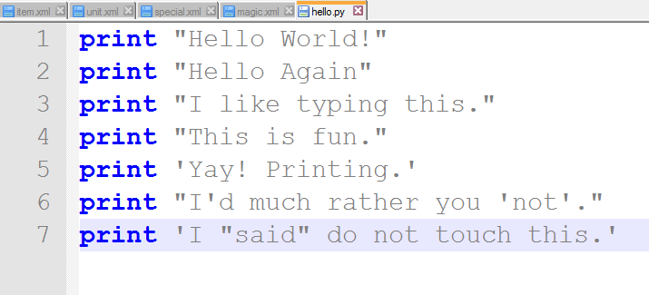
A first good program

Slide 10
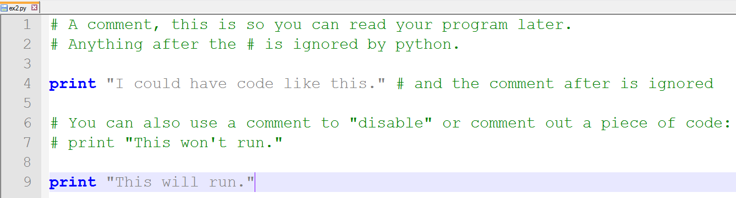
Comments

Slide 11
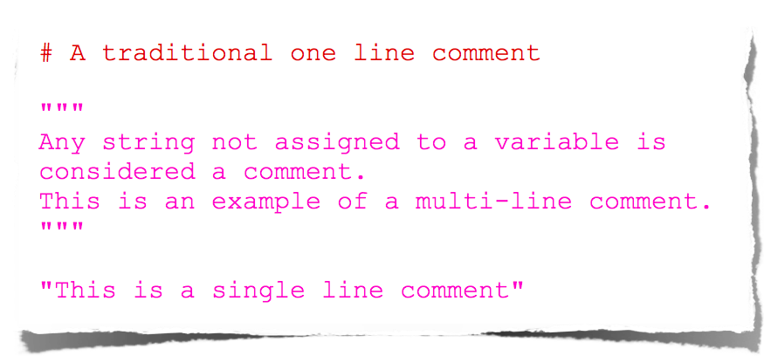
More about Comments

Slide 12
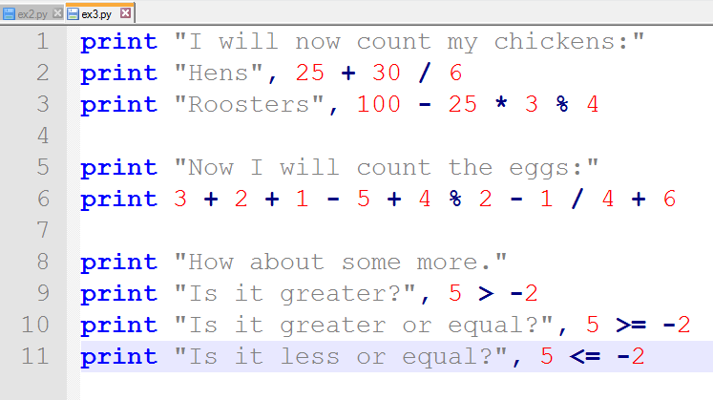
Numbers and Math

Slide 13
Variable
age = 23 # integer
hello = “hello world” # string
average_point = 10.1 # floating point
my_house = none # null

Slide 14
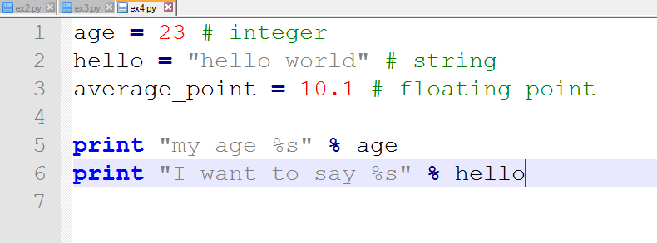
More Variables and Printing

Slide 15
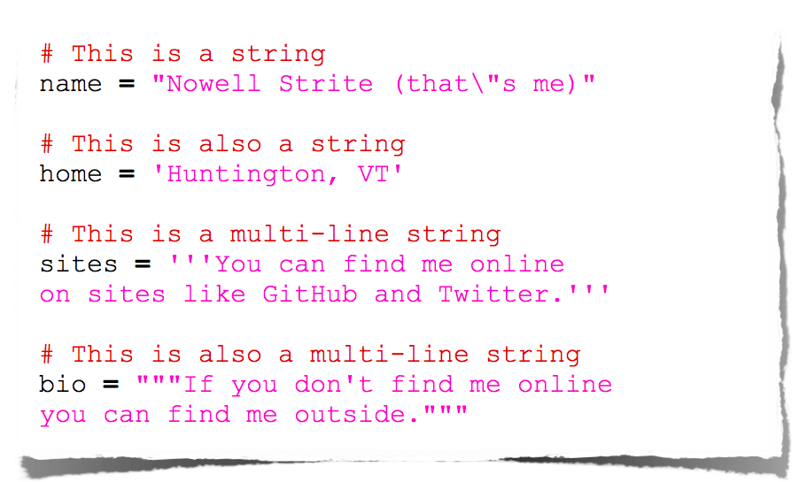
Strings

Slide 16
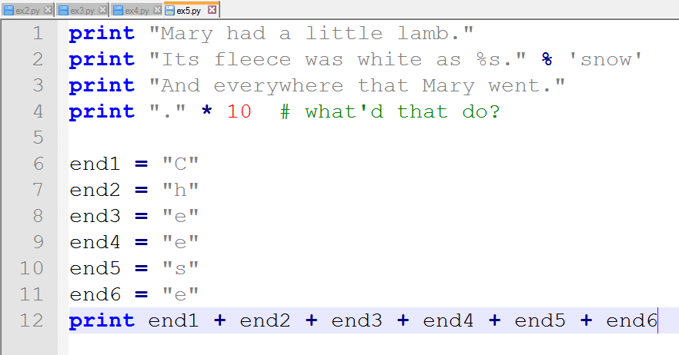
More about strings

Slide 17
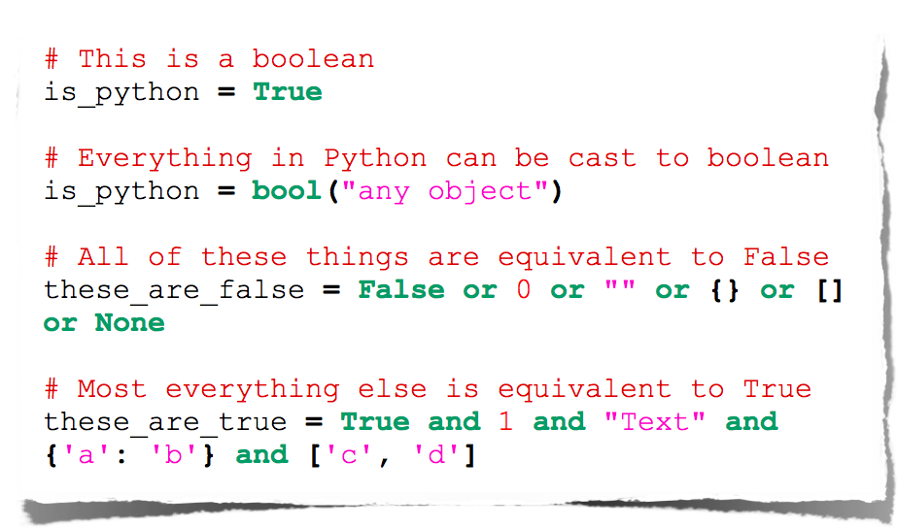
Booleans

Slide 18
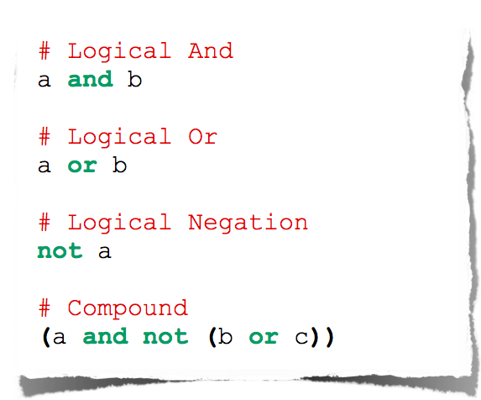
Logical Comparison

Slide 19
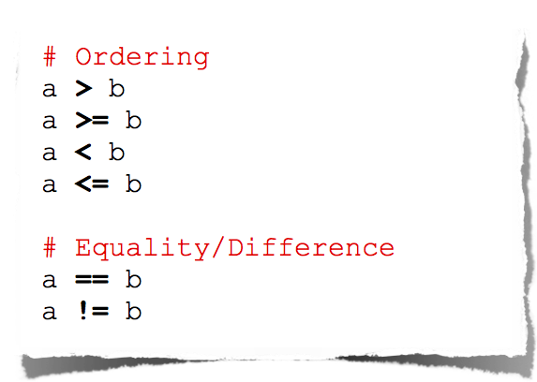
Arithmetic Comparison

Slide 20
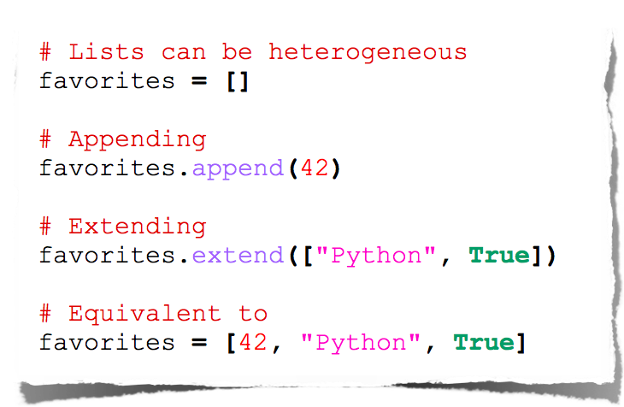
Lists(1)
Notes:
Heterogeneous: mixed of any type

Slide 21
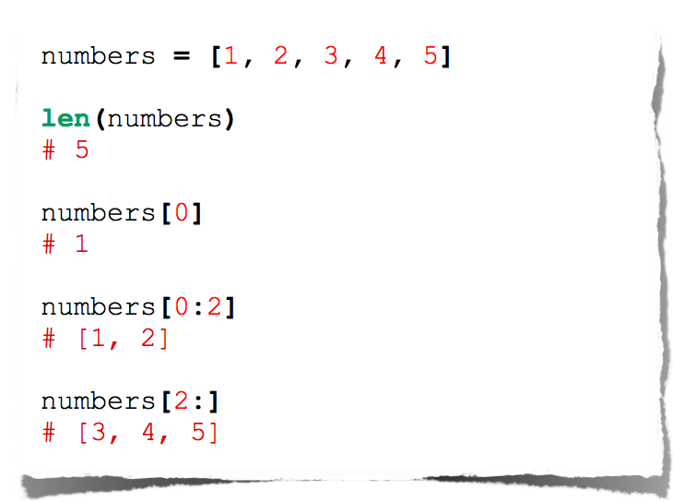
Lists(2)

Slide 22
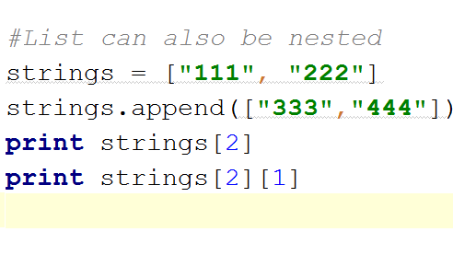
Lists(3)

Slide 23
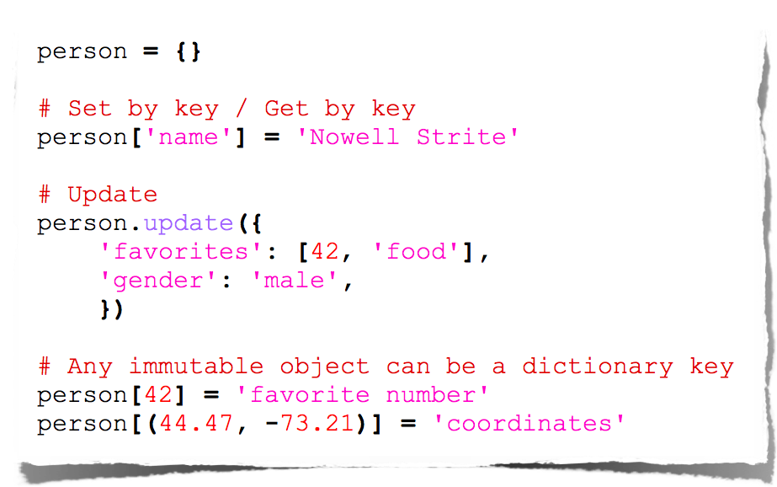
Dictionaries (Hash Map)
Notes:
Any hashable type can be a dictionary key

Slide 24
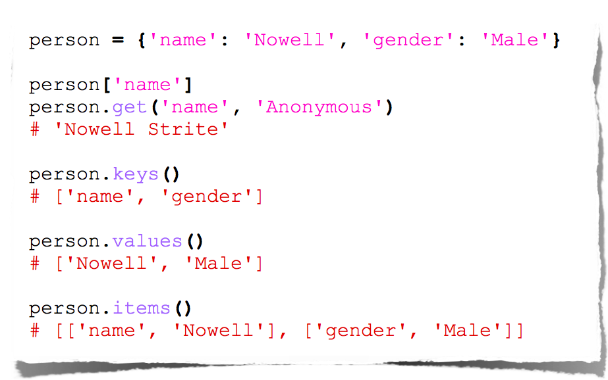
Dictionary Methods
Notes:
Any hashable type can be a dictionary key

Slide 25
Indentation
Most languages don’t care about indentation
Most humans do
We tend to group similar things together

Slide 26
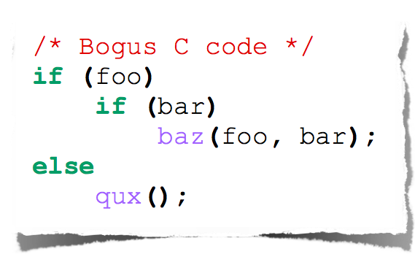
Indentation
The else here actually belongs to the 2nd if statement

Slide 27
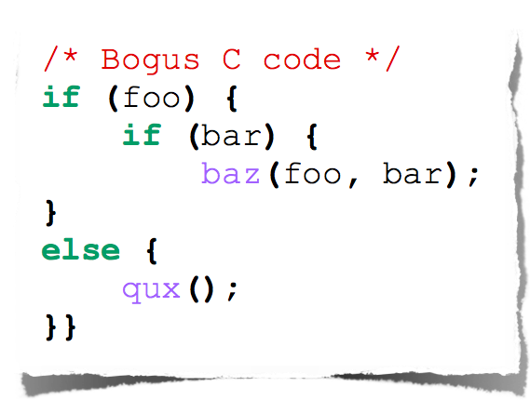
Indentation
The else here actually belongs to the 2nd if statement

Slide 28
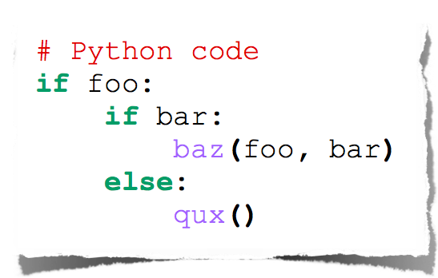
Indentation
Python embraces indentation

Slide 29
Control Flow

Slide 30
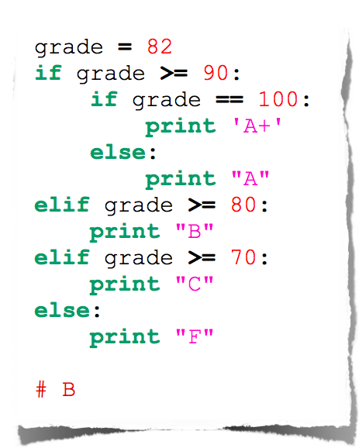
Conditionals

Slide 31
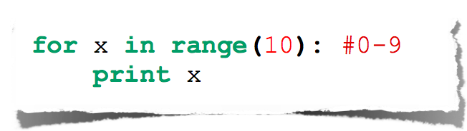
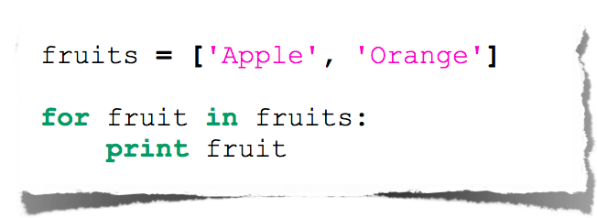
For Loop

Slide 32
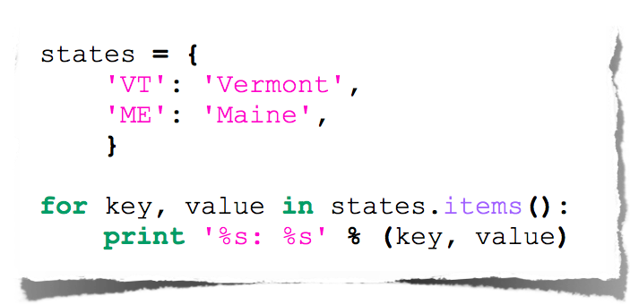
Expanded For Loop
Notes:
States.items() return a nested list [(‘VT', ‘Vermont'), (‘Me', ‘Maine')]

Slide 33
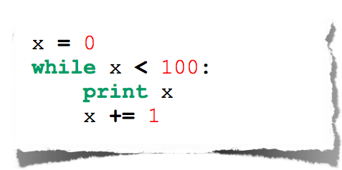
While Loop

Slide 34
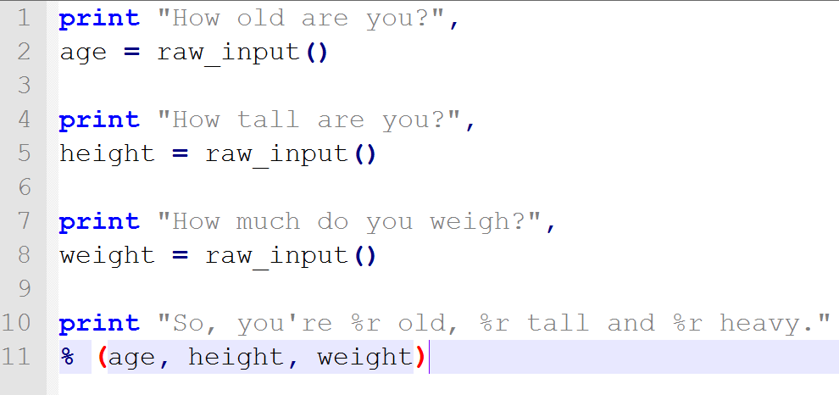
Standard IO (1)

Slide 35
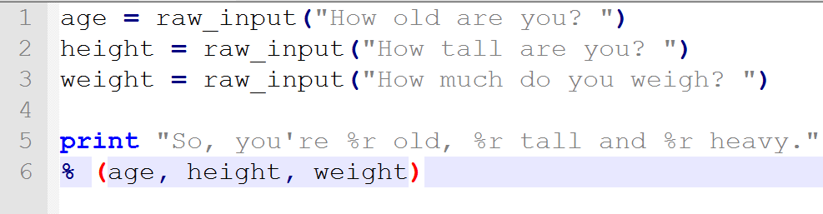
Standard IO (2)

Slide 36
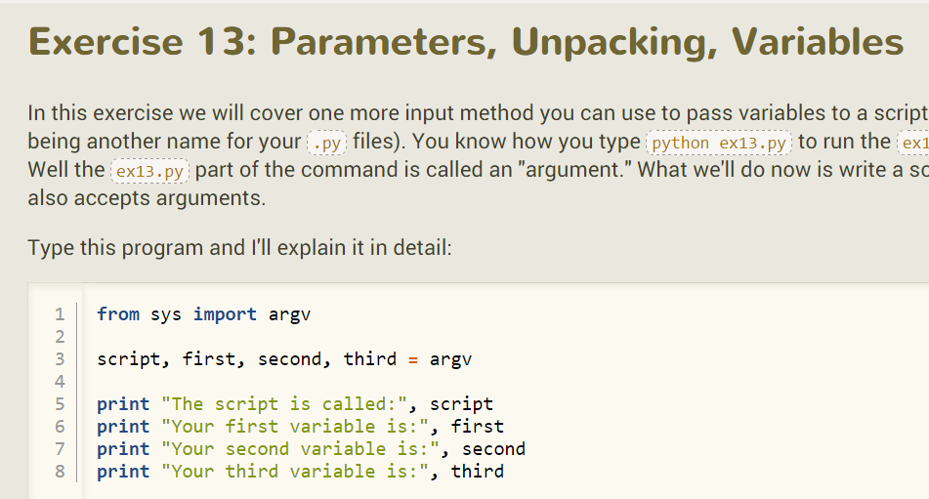

Slide 37
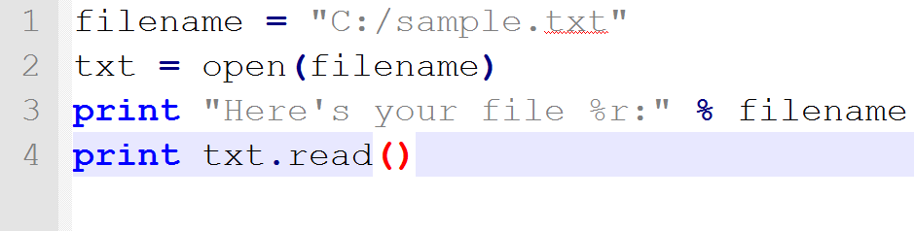
Reading and Writing Files

Slide 38
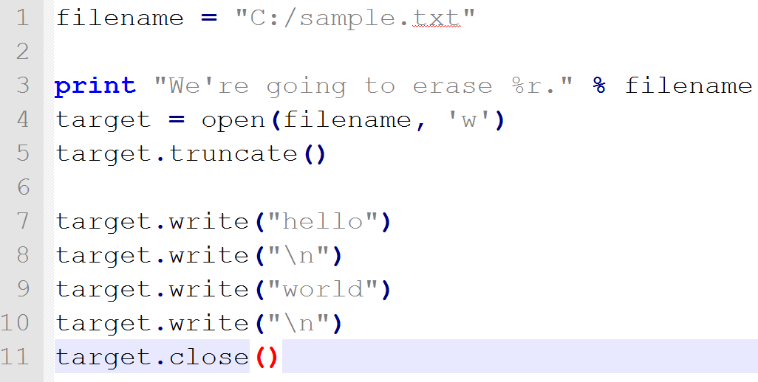
Reading and Writing Files(2)

Slide 39
Reading and Writing Files(3)
File methods:
close -- Closes the file. Like File->Save.. in your editor.
read -- Reads the contents of the file. You can assign the result to a variable.
readline -- Reads just one line of a text file.
truncate -- Empties the file. Watch out if you care about the file.
write('stuff') -- Writes "stuff" to the file.

Slide 40
Functions

Slide 41
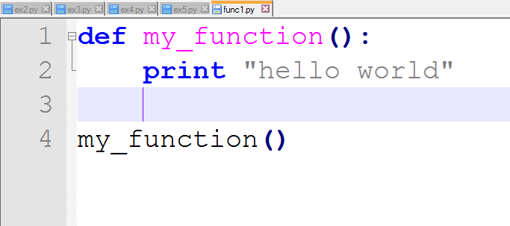
Basic Function

Slide 42
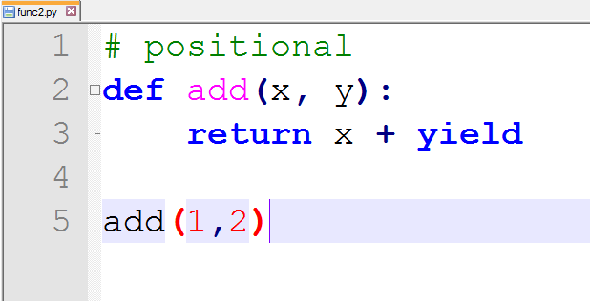
Function Arguments(1)

Slide 43
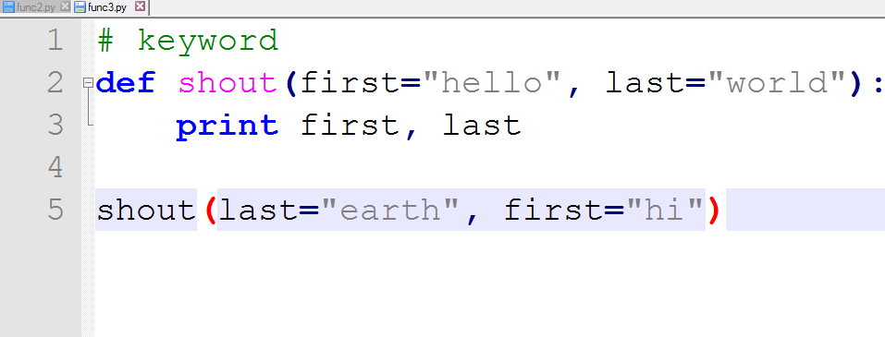
Function Arguments(2)

Slide 44
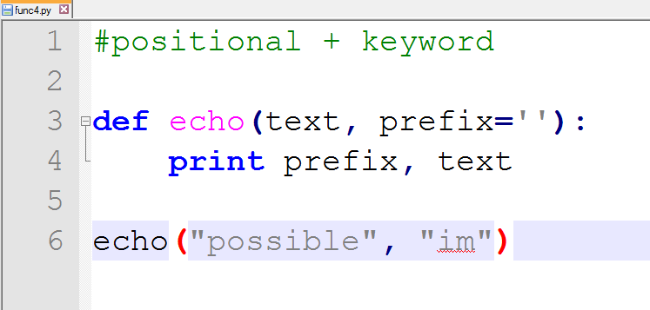
Function Arguments(3)

Slide 45
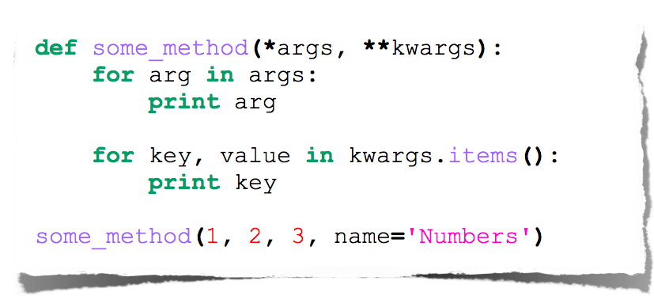
Function Arguments(4)
Arbitrary Arguments
Notes:
def foo(*rest, **rests):
print rest
print rests.get("action")
a = 1
b = 2
c = 3
d = 4
foo(a, b, c, d, action="sum", number1=3, number2=5)

Slide 46
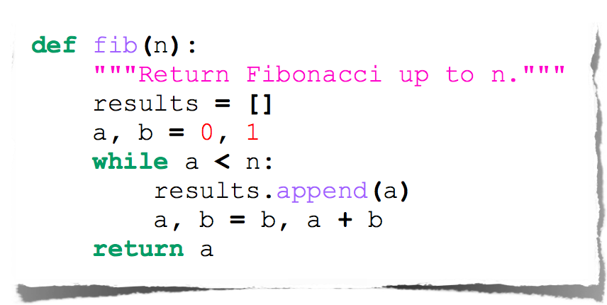
Fibonacci

Slide 47
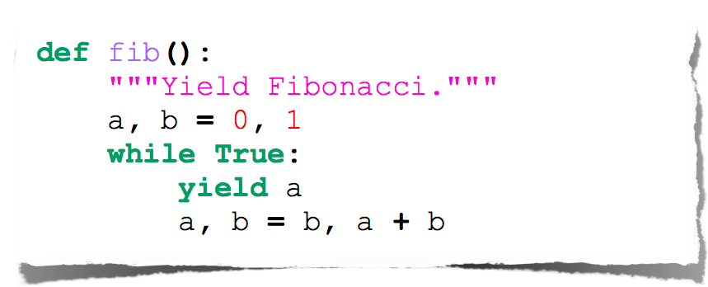
Fibonacci Generator

Slide 48
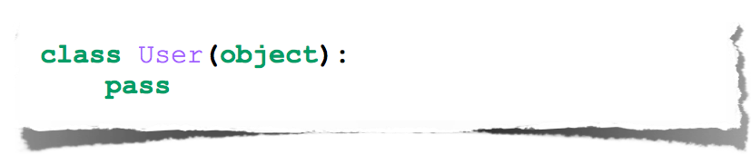
Classes

Slide 49
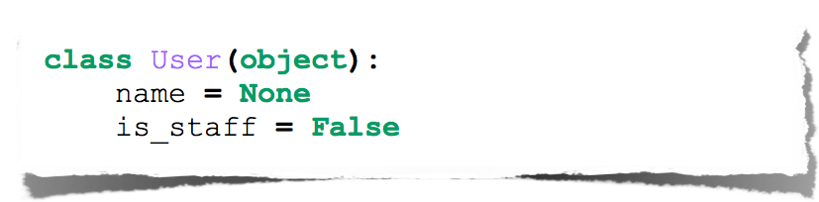
Class Attributes

Slide 50
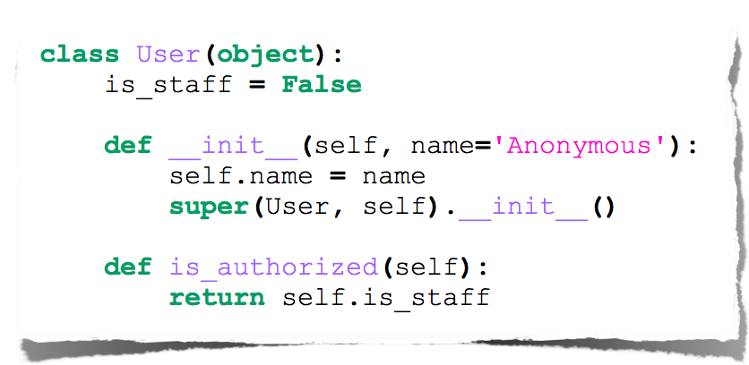
Class Methods

Slide 51
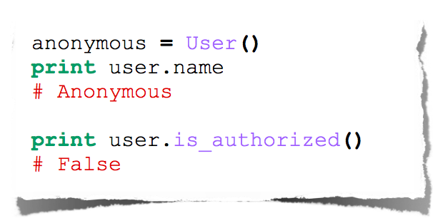
Class Instantiation & Attribute Access

Slide 52
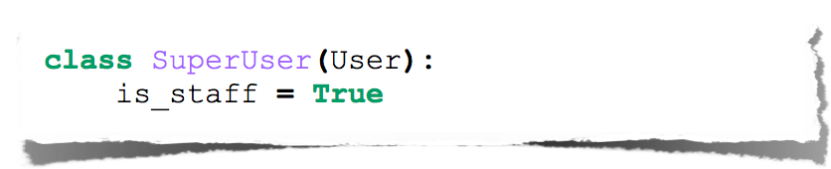
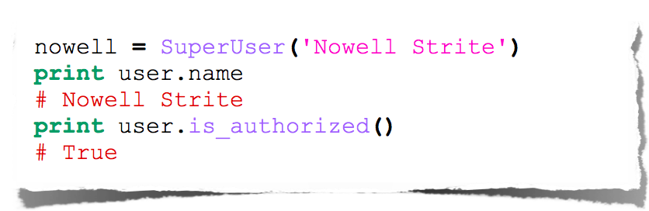
Class Inheritance

Slide 53
Python’s Way
No interfaces
No real private attributes/functions
Private attributes start (but do not end) with double underscores.
Special class methods start and end with double underscores.
__init__, __doc__, __cmp__, __str__

Slide 54
Imports
Allows code isolation and re-use
Adds references to variables/classes/functions/etc. into current namespace

Slide 55
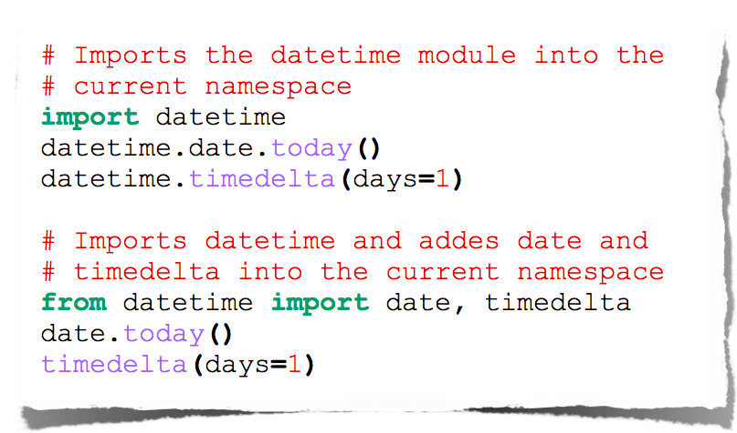
Imports

Slide 56
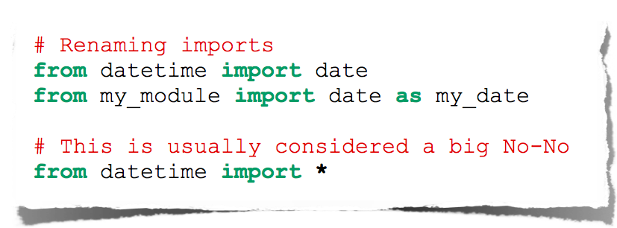
More Imports

Slide 57
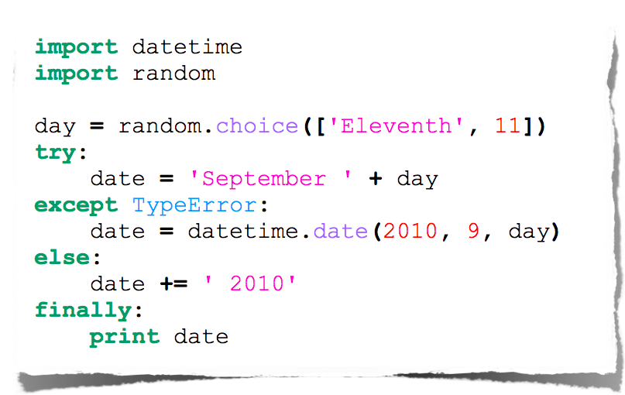
Error Handling
Notes:
import datetime
import random
day = random.choice(["Eleventh", 11]);
try:
day = "Septemper " + day
except TypeError:
day = datetime.date(2010, 9, day)
else:
day += ' 2010'
finally:
print day

Slide 58
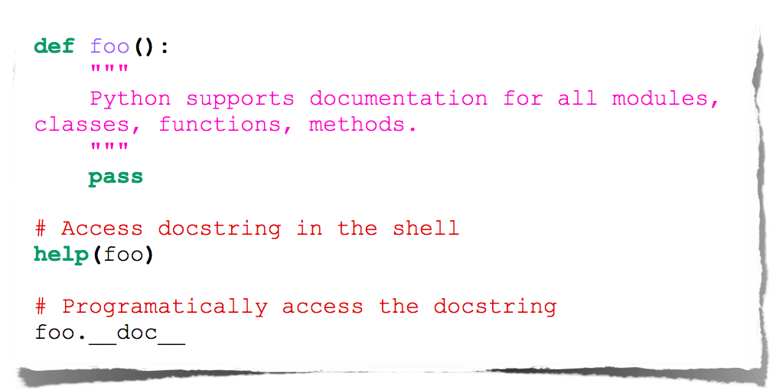
Documentation

Slide 59
Going Further
Decorators
Context Managers
Lambda functions
Generators
...

Slide 60
Questions?

Slide 61
Thanks!

